Slide 1
Works
1
Finish all of the attention heatmap for different biomarker prediction

Slide 2
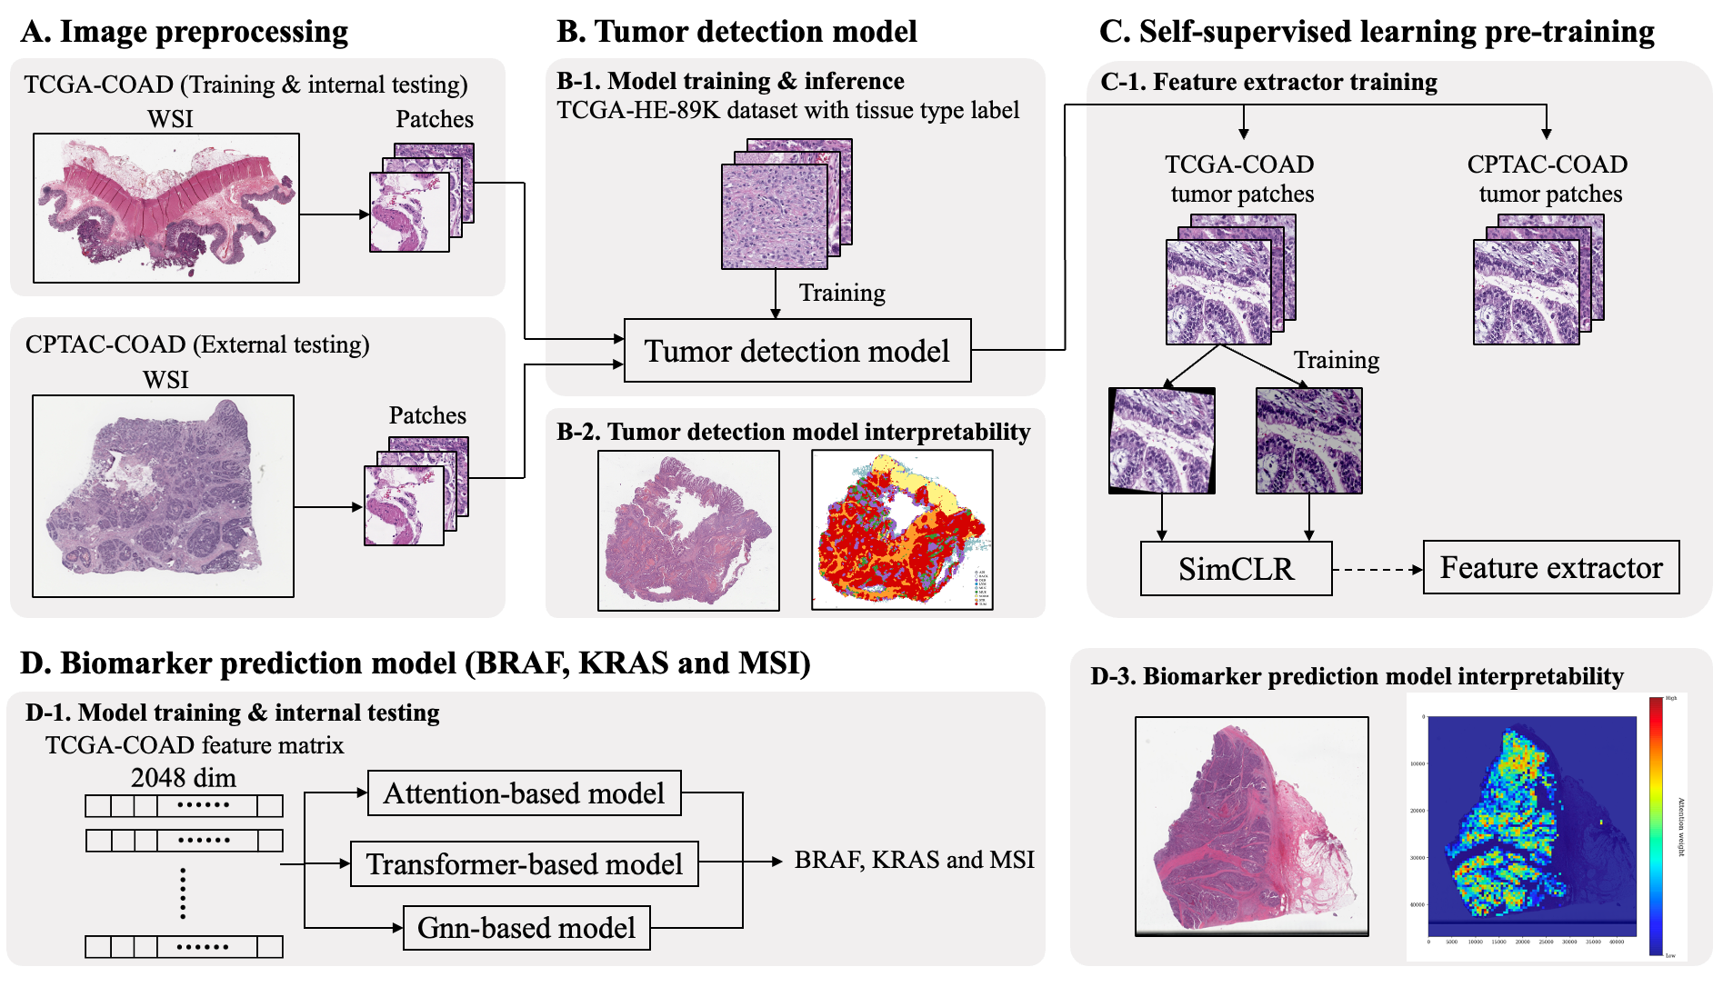

Slide 3
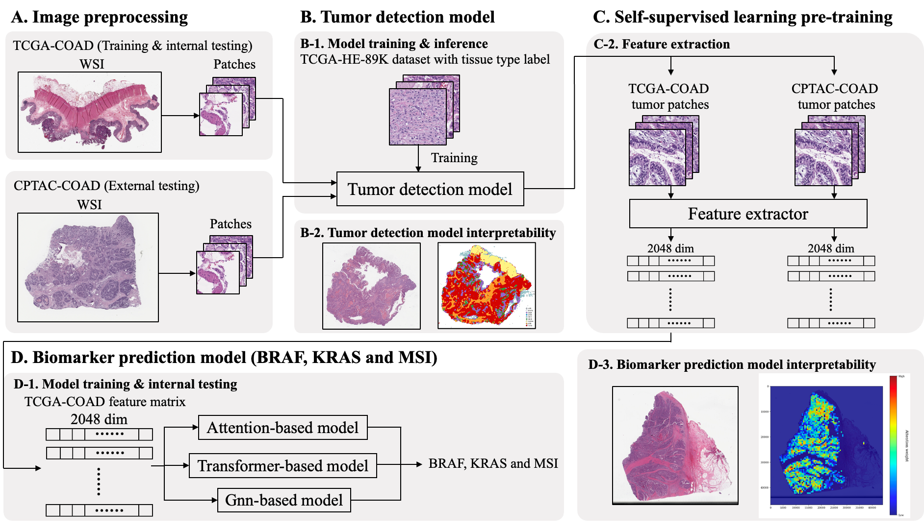

Slide 4
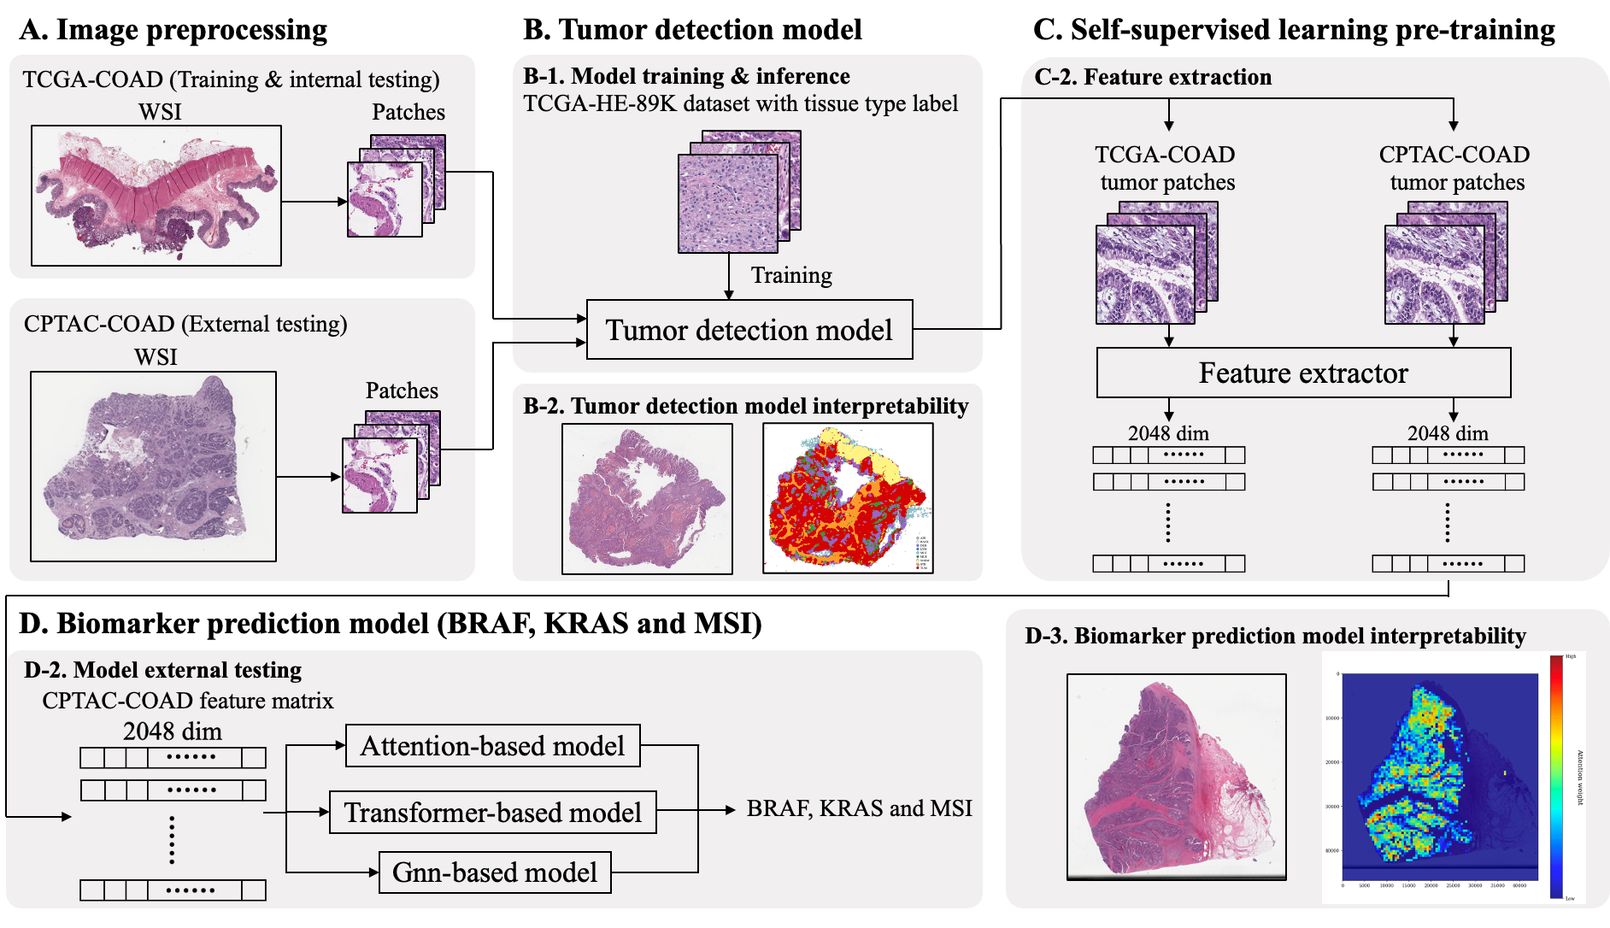

Slide 5
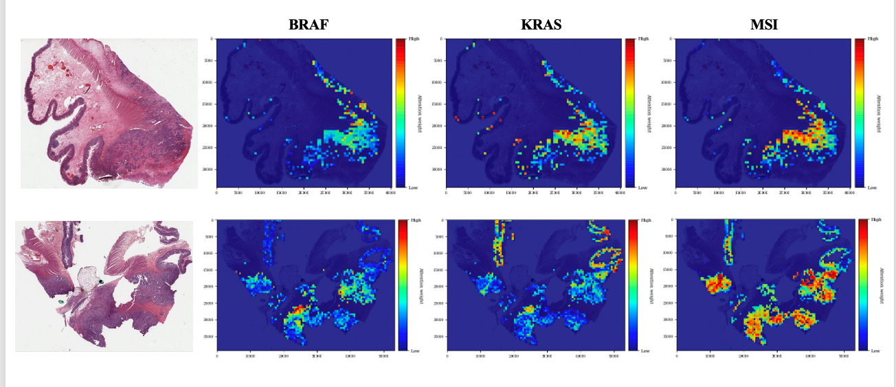
Attention heatmap

Slide 6
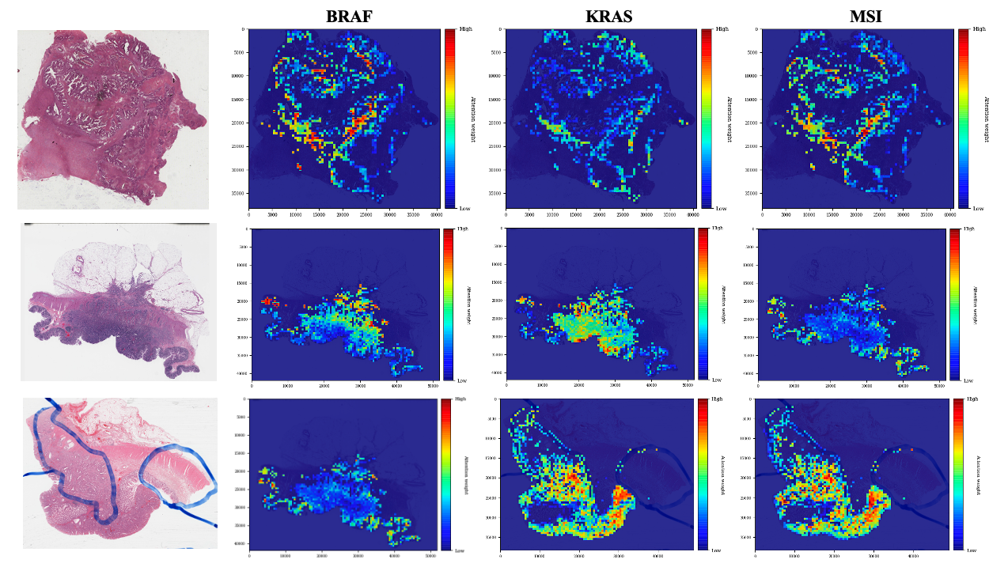

Slide 7
Future works
1
Adjust GNN architecture of biomarker prediction
2
Majority voting

